Slide 1
Introducing Bitcoin
Created by Satoshi Nakamoto in 2008. It was published as a white paper ‘Bitcoin: A Peer-to-Peer Electronic Cash System. This paper is available at https://bitcoin.org/en/bitcoin-paper’
It is the most successful digital currency with billions of dollars invested.
It has gained high number of users and investors, frequent new coverage, and growing number of Bitcoin-based startups and exchanges.
Bitcoin futures are traded on the Chicago Mercantile Exchange (CME).
Bitcoin can be defined in various ways; it’s a protocol, a digital currency, and a platform.
It is a combination of a P2P network, protocols, and software that facilitates the creation and usage of the digital currency.
Nodes in this P2P network talk to each other using the Bitcoin protocol.

Slide 2
Introducing Bitcoin
Various ideas and techniques from cryptography and distributed computing such as Merkle trees, hash functions, and digital signatures were used to design Bitcoin.
BitGold, b-money, hashcash, and cryptographic time-stamping also provided some groundwork for the invention of Bitcoin.
It is the first ever truly decentralized currency.
Bitcoin solves several historically difficult problems related to electronic cash and distributed systems, including:
  The Byzantine generals problem
  Sybil attacks
  The double-spending problem

Slide 3
Bitcoin Address
A Bitcoin address is a unique string of letters and numbers that identifies where bitcoins can be sent on the Bitcoin network.
You can think of it like an email address or a bank account number—but instead of receiving emails or bank transfers, it receives Bitcoin.
Possession of bitcoins and the transfer of value via transactions are reliant upon private keys, public keys, and addresses.
Elliptic Curve Cryptography (ECC) is used to gener ate public and private key pairs in the Bitcoin network.
Private keys are required to be kept safe and normally reside only on the owner’s side. Private keys are used to digitally sign transactions, proving ownership of bitcoins.

Slide 4
Bitcoin Address
A Bitcoin address is a unique string of letters and numbers that identifies where bitcoins can be sent on the Bitcoin network.
You can think of it like an email address or a bank account number—but instead of receiving emails or bank transfers, it receives Bitcoin.
Possession of bitcoins and the transfer of value via transactions are reliant upon private keys, public keys, and addresses.
Elliptic Curve Cryptography (ECC) is used to gener ate public and private key pairs in the Bitcoin network.
Private keys are required to be kept safe and normally reside only on the owner’s side. Private keys are used to digitally sign transactions, proving ownership of bitcoins.
Address is not your private key: The address is public. Your private key, which gives you control over the Bitcoin at that address, must never be shared.

Slide 5
Wallet Import Format (WIF)
Wallet Import Format (WIF) is a standardized way of encoding a Bitcoin private key into a human-readable string. It allows users to export, back up, and import private keys between different Bitcoin wallets.
A WIF is not the private key itself; rather, it is an encoded representation of the private key that includes additional information to detect errors and indicate how the key should be used.
WIF can be converted into a private key and vice versa.
For example, consider the following private key: A3ED7EC8A03667180D01FB4251A546C2B9F2FE33507C68B7D9D4E1FA5714195201
  When converted into WIF format, it looks as shown here: L2iN7umV7kbr6LuCmgM27rBnptGbDVc8g4ZBm6EbgTPQXnj1RCZP

Slide 6
Mini Private Key
A Mini Private Key is a shortened representation of a Bitcoin private key that was designed to make paper wallets easier to print, write down, and manually enter. It was primarily used in the early years of Bitcoin, particularly for physical Bitcoin products such as Casascius coins.
Unlike Wallet Import Format (WIF), which is an encoded version of a 256-bit private key, a mini private key is a short secret string from which the actual 256-bit Bitcoin private key is generated using a cryptographic hash function.
Why was the Mini Private Key introduced?
A normal Bitcoin private key in WIF looks like this:
L1aW4aubDFB7yfras2S1mMEG7Vv6K6wQnKj3kD7vYQ1R7x4H2Y9a
It contains about 51–52 characters. This is relatively long for printing on physical coins, writing on paper, engraving on metal, entering manually.

Slide 7
Mini Private Key
A mini private key looks like:
S6c56bnXQiBjk9mqSYE7ykVQ7NzrRy
It contains only 22, 26, or 30 characters, making it much easier to handle.
Characteristics of a Mini Private Key
A mini private key:
  begins with the letter S
  contains only Base58 characters
  is much shorter than WIF
  is not the actual Bitcoin private key
  must be converted into a 256-bit private key before use

Slide 8
Mini Private Key
How does it work?
Instead of storing the actual private key, Bitcoin software performs the following steps:
Mini Private Key
│
▼
SHA-256 Hash
│
▼
256-bit Bitcoin Private Key
│
▼
Public Key
│
▼
Bitcoin Address

Slide 9
Mini Private Key
How does it work?
Example
Suppose the mini private key is
S6c56bnXQiBjk9mqSYE7ykVQ7NzrRy
The wallet computes
SHA256(
S6c56bnXQiBjk9mqSYE7ykVQ7NzrRy
)
The output becomes the actual private key.
For example:
3A8B6C9D...
This 32-byte value is then used exactly like any normal Bitcoin private key.

Slide 10
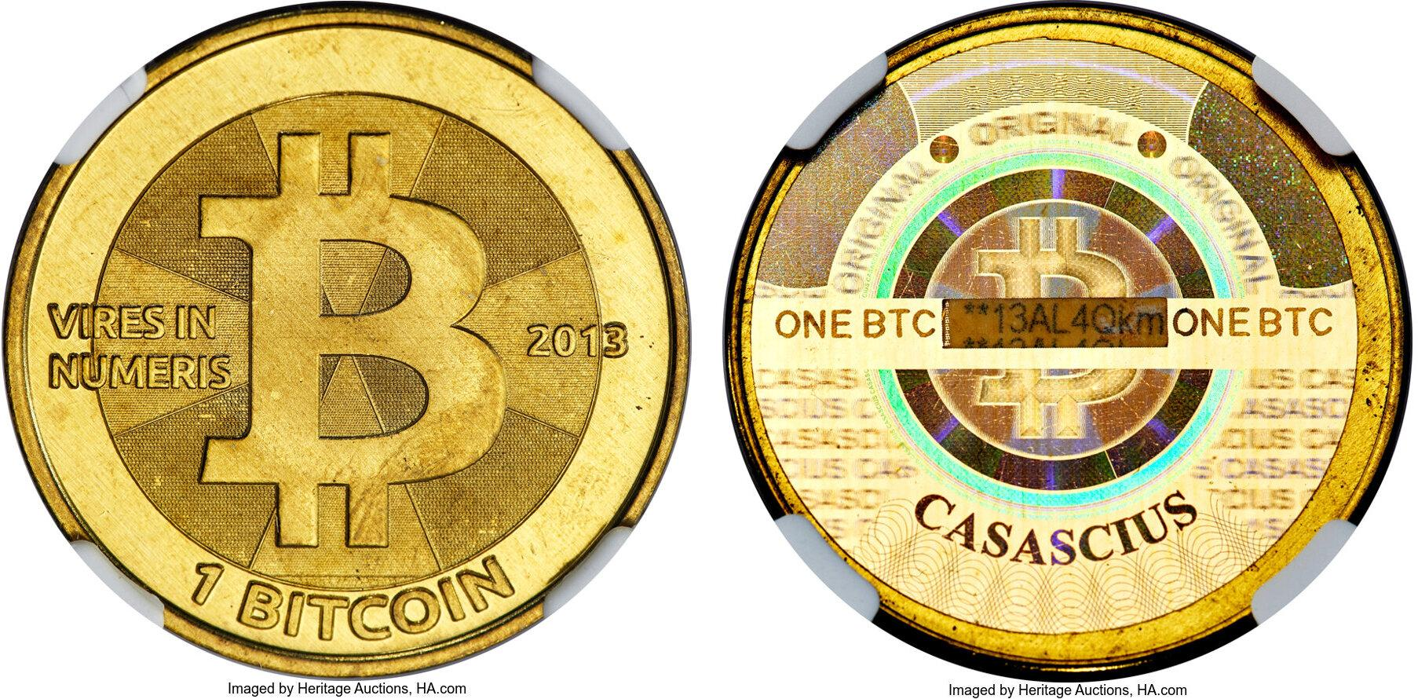
Physical Bitcoin
A physical Bitcoin is a real-world object—usually a coin, token, or card—that securely stores the information needed to access a certain amount of Bitcoin on the blockchain. Contrary to what the name suggests, the Bitcoin itself does not exist inside the object; the bitcoins remain recorded on the blockchain. The physical item simply protects the private key that allows the owner to spend those bitcoins.
It is as a secure container for a Bitcoin private key, rather than the Bitcoin itself.
Bitcoin is entirely digital.
A physical Bitcoin is not like a physical gold coin or paper currency.

Slide 11
How does Physical Bitcoin work?
A manufacturer first creates:
a Bitcoin private key
the corresponding public key
the corresponding Bitcoin address
The manufacturer then sends a certain amount of Bitcoin to that address.
The private key is hidden inside the physical coin using a tamper-evident seal.
Generate Private Key
▼
Generate Public Key
▼
Generate Bitcoin Address
▼
Deposit Bitcoins
▼
Hide Private Key inside Coin

Slide 12
Components of Physical Bitcoin
Tamper-Evident Seal
A holographic sticker protects the private key.
If someone removes the sticker,
it leaves visible damage,
making it obvious that the private key may have been exposed.
Front of Coin
Bitcoin Logo
Address
Back
Hologram Sticker
(Private key underneath)
Public Address
Printed on the outside.
Example:
bc1q...
Anyone can use this address to:
verify the balance
send additional bitcoins
Private Key
Hidden beneath a security hologram.
Example (often in WIF or Mini Private Key format):
L4abcd...
or
S6c56bnXQi...
This key must remain secret.

Slide 13
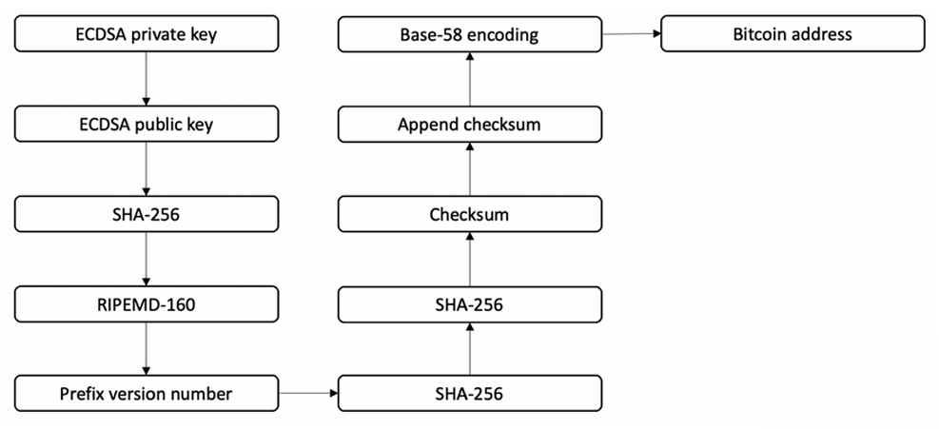
Addresses generation procedure in Bitcoin
The following diagram shows how an address is generated, from generating the private key to the final output of the Bitcoin address:

Slide 14
Addresses generation procedure in Bitcoin
In the preceding diagram, there are a number of steps:
In the first step, we have a randomly generated ECDSA private key.
The public key is derived from the ECDSA private key.
The public key is hashed using the SHA-256 cryptographic hash function.
The hash generated in step 3 is hashed using the RIPEMD-160 hash function.
The version number is prefixed to the RIPEMD-160 hash generated in step 4.
The result produced in step 5 is hashed using the SHA-256 cryptographic hash function.
SHA-256 is applied again.

Slide 15
Addresses generation procedure in Bitcoin
8. The first 4 bytes of the result produced from step 7 are the address checksum.
9. This checksum is appended to the RIPEMD-160 hash generated in step 4.
10. The resultant byte string is encoded into a Base58-encoded string by applying the Base58 encoding function.
11. Finally, the result is a typical Bitcoin address.

Slide 16
Base58 Encoding
Base58 is a binary-to-text encoding scheme used to represent large numbers (like hashes) in a compact, human-friendly string — while deliberately avoiding characters that are easily confused with each other.
The Character Set
Base58 uses 58 characters:
123456789ABCDEFGHJKLMNPQRSTUVWXYZabcdefghijkmnopqrstuvwxyz
Excluded Character | Why
0 (zero) | Looks like O
O (capital o) | Looks like 0
I (capital i) | Looks like l
l (lowercase L) | Looks like I and 1
+ / | Non-alphanumeric, can break URLs / double-click selection

Slide 17
Base58Check Encoding
Base58Check is Base58 encoding plus a version byte and checksum. It's the actual scheme Bitcoin uses for addresses and private keys — plain Base58 alone is never used on its own in Bitcoin, because it has no way to detect typos or identify what kind of data it's encoding.
Why Base58 Alone Isn't Enough?
Plain Base58 just turns bytes into a compact string. But it has two problems:
No error detection — mistype one character, and you get a different but still valid-looking string. Funds sent there are lost forever.
No type information — you can't tell if a decoded payload is a public key hash, a private key, or something else.
Base58Check fixes both.

Slide 18
Base58Check Encoding
The Full Algorithm
  1. version_byte = identifies the data type (e.g., 0x00 for mainnet P2PKH)
  2. payload = version_byte + data (e.g, hash160 of pubkey)
  3. checksum = first 4 bytes of SHA256(SHA256(payload))
  4. full_payload = payload + checksum
  5. address = Base58Encode(full_payload)
Step-by-Step Example: Building a P2PKH Address
Say we already have the RIPEMD-160(SHA-256(pubkey)) hash:
hash160 = f54a5851e9372b87810a8e60cdd2e7cfd80b6e31
Step 1 — Prepend version byte
version (mainnet P2PKH) = 0x00
payload = 00 f54a5851e9372b87810a8e60cdd2e7cfd80b6e31

Slide 19
Base58Check Encoding
Step 2 — Double SHA-256 the payload
  sha1 = SHA256(payload)
  sha2 = SHA256(sha1)
  Step 3 — Take first 4 bytes as checksum
  checksum = sha2[0:4] → e.g., d61967f6
Step 4 — Append checksum to payload
  full = 00 f54a5851e9372b87810a8e60cdd2e7cfd80b6e31 d61967f6
  (1 byte) (20 bytes) (4 bytes)
  = 25 bytes total
Step 5 — Base58 encode the whole thing
  Base58Encode(full) = "1PMycacnJaSqwwJqjawXBErnLsZ7RkXUAs"
That's a real, spendable Bitcoin address.

Slide 20
Base58Check Encoding
Decoding & Validation (Reverse Process)
When a wallet receives an address to send to, it:
  1. Base58Decode(address) → full_payload
  2. Split into: payload (all but last 4 bytes) + checksum (last 4 bytes)
  3. Recompute: SHA256(SHA256(payload))[0:4]
  4. Compare to the provided checksum
  5. If mismatch → REJECT (typo or corruption detected)
  6. If match → extract version byte to confirm expected type

Slide 21
Full Pipeline: Private Key → Public Key → Address → Decode & Validate
Part 1: Private Key → Public Key
Private Key (hex):
0C28FCA386C7A227600B2FE50B7CAE11EC86D3BF1FBE471BE89827E19D72AA1
Using secp256k1 elliptic curve multiplication (PublicKey = PrivateKey × G, where G is the curve's generator point), this produces an uncompressed public key:
Public Key (hex):
0450863AD64A87AE8A2FE83C1AF1A8403CB53F53E486D8511DAD8A04887E5B23522CD470243453A299FA9E77237716103ABC11A1DF38855ED6F2EE187E9C582BA6
The leading 04 byte marks it as uncompressed (65 bytes total: 1 prefix + 32-byte X + 32-byte Y coordinate).
This step is one-way — you cannot derive the private key back from the public key (that's the whole basis of ECDSA security).

Slide 22
Full Pipeline: Private Key → Public Key → Address → Decode & Validate
Part 2: Public Key → Hash160
sha256_1 = SHA256(pubkey_bytes)
hash160 = RIPEMD160(sha256_1)
Actual computed values:
SHA256(pubkey):
600ffe422b4e00731a59557a5cca46cc183944191006324a447bdb2d98d4b408
RIPEMD160(SHA256(pubkey)) = hash160:
010966776006953d5567439e5e39f86a0d273bee
This double-hash (SHA-256 then RIPEMD-160) is why it's often written HASH160(). It compresses the 65-byte public key down to a fixed 20 bytes, and adds a layer of protection (if SHA-256 were ever broken, RIPEMD-160 still stands between the attacker and your actual public key).

Slide 23
Full Pipeline: Private Key → Public Key → Address → Decode & Validate
Part 3: Encoding — Hash160 → Address
Step 1 — Build the payload
version_byte = 00
payload = 00 + 010966776006953d5567439e5e39f86a0d273bee
= 00010966776006953d5567439e5e39f86a0d273bee
Step 2 — Double SHA-256 the payload, take first 4 bytes
SHA256(payload):
445c7a8007a93d8733188288bb320a8fe2debd2ae1b47f0f50bc10bae845c094
SHA256(SHA256(payload)):
d61967f63c7dd183914a4ae452c9f6ad5d462ce3d277798075b107615c1a8a30
Checksum = d61967f6

Slide 24
Full Pipeline: Private Key → Public Key → Address → Decode & Validate
Step 3 — Concatenate and Base58 encode
full_payload = 00010966776006953d5567439e5e39f86a0d273beed61967f6
(25 bytes: 1 version + 20 hash160 + 4 checksum)
Base58Encode(full_payload) = 16UwLL9Risc3QfPqBUvKofHmBQ7wMtjvM
That's the final, real, spendable-looking Bitcoin address.

Slide 25
Full Pipeline: Private Key → Public Key → Address → Decode & Validate
Part 4: Decoding & Validation (the reverse process)
This is what a wallet does the instant you paste an address into the "send to" field.
Step 1 — Base58 decode back to raw bytes
Input address: 16UwLL9Risc3QfPqBUvKofHmBQ7wMtjvM
Decoded (hex): 00010966776006953d5567439e5e39f86a0d273beed61967f6
Length: 25 bytes ✓ (matches expected P2PKH length)
Step 2 — Split into payload and checksum
payload = 00010966776006953d5567439e5e39f86a0d273bee (21 bytes)
checksum_given = d61967f6 (4 bytes)

Slide 26
Full Pipeline: Private Key → Public Key → Address → Decode & Validate
Step 3 — Extract version byte and hash160
version_byte = 00 → recognized as mainnet P2PKH
hash160 = 010966776006953d5567439e5e39f86a0d273bee
Step 4 — Recompute the checksum independently
recomputed = SHA256(SHA256(payload))[0:4]
= d61967f6
Step 5 — Compare
checksum_given = d61967f6
recomputed = d61967f6
Match? → True
Since they match, the wallet accepts the address as structurally valid and knows it's a P2PKH type (because of the 00 version byte).

Slide 27
Full Pipeline: Private Key → Public Key → Address → Decode & Validate
Part 5: What Happens With a Typo (Real Demonstration)
I changed just the last character of the address (M → N):
Original: 16UwLL9Risc3QfPqBUvKofHmBQ7wMtjvM
Tampered: 16UwLL9Risc3QfPqBUvKofHmBQ7wMtjvN
Decoding the tampered version:
Given checksum: d61967f7
Recomputed checksum: d61967f6
Valid? → False ❌
The single-character change completely alters the decoded byte string (Base58 has no positional independence — one changed character reshuffles the underlying integer), so the checksum comparison fails immediately. The wallet would reject this address outright and refuse to send funds.

Slide 28
Types of Bitcoin Addresses
P2PKH or Legacy Address Format
P2PKH stands for Pay-to-Public-Key-Hash. It's the original Bitcoin address format, still widely used today.
26 to 35 characters long and uses Base58Check encoding
A P2PKH or legacy address, always starts with 1. For example, 1BvBMSEYstWetqTFn5Au4m4GFg7xJaNVN2.
P2PKH stands for Pay-to-Pubkey Hash, which means paying to a hash of the recipient’s public key.
Legacy addresses are not SegWit compatible, but Bitcoin from a P2PKH address can be sent to a SegWit address without any problems.
Transactions from a P2PKH address typically have higher fees due to their larger size.

Slide 29
Types of Bitcoin Addresses
How P2PKH Address generated?
You generate a public key from your private key (via elliptic curve cryptography).
The public key is hashed twice — first with SHA-256, then with RIPEMD-160 — producing a 20-byte hash.
A version byte (0x00 for mainnet) is prepended.
A checksum (first 4 bytes of double SHA-256 of the above) is appended.
The result is encoded in Base58 to produce the human-readable address.

Slide 30
Bitcoin Addresses
P2SH Address Format
P2SH was introduced in 2012 (BIP 16) to let Bitcoin addresses represent any redeem script, not just a single public key. This enabled multisig, complex spending conditions, and later became the vehicle for wrapping SegWit.
P2SH addresses have a structure similar to P2PKH addresses but start with a 3, for example 3J98t1WpEZ73CNmQviecrnyiWrnqRhWNLy.
P2SH stands for Pay-to-Script Hash and enables more complex functionality than legacy addresses. It is commonly used for multisig addresses, where multiple digital signatures are required to authorize a transaction.
P2SH addresses are also used for nonnative SegWit transactions through P2WPKH-in-P2SH. For most users, the important thing is that this address type is widely supported and can be used to send funds to both P2PKH and bech32 addresses.

Slide 31
Bitcoin Addresses
Bech32 Address Format
Bech32 addresses have a distinct appearance, starting with “bc1,” and are longer than legacy or P2SH addresses due to the prefix.
Bech32 is the native SegWit address format, supported by most software and hardware wallets, but not fully embraced by all exchanges.
While less than one percent of Bitcoin is currently stored in bech32 addresses, this number is gradually increasing.

Slide 32
Bitcoin Addresses
Bitcoin Cash Address Formats
Bitcoin Cash (BCH) addresses can follow either the legacy format (starting with a 1) or the Cash Address (Cash Addr) format.
The Cash Addr format is based on bech32 and starts with “q” or “bitcoincash:q.”
BCH wallets can support both formats, allowing users to switch between them.
The primary reason for using the Cash Addr format is to distinguish BCH from BTC (Bitcoin) and prevent funds from being sent to the wrong address.

Slide 33
Bitcoin Addresses
Vanity addresses:
As Bitcoin addresses are based on Base58 encoding, it is possible to generate addresses that contain human-readable messages and are personalized. An example is 1BasHiry2VoCQCdX6X64oxvKRuf7fW6qGr—note that the address contains the name BasHir. Vanity addresses are generated using a brute-force method. There are various online services that provide this service.
Multi-signature addresses:
These addresses require multiple private keys. In practical terms, this means that in order to release the coins, a certain set number of signatures is required. This is also known as M of N multisig. Here, M represents the threshold or minimum number of signatures required from N number of keys to release the bitcoins.

Slide 34
Wallet
A Bitcoin wallet is a software application or hardware device that is used to store, send, and receive Bitcoin. It is essentially a digital wallet that holds a user’s private keys, which are used to access their Bitcoin holdings on the blockchain.
There are several types of Bitcoin wallets, including: –
Software wallets: These are digital wallets that can be downloaded and installed on a computer or mobile device. They can be further categorized into desktop wallets, mobile wallets, and web wallets.
Hardware wallets: These are physical devices that store a user’s private keys offline. They are considered to be the most secure type of Bitcoin wallet.
Paper wallets: These are physical copies of a user’s private keys that are printed out on paper. They are also considered to be a relatively secure option, but they can be vulnerable to physical damage or theft.

Slide 35
Custodial Wallet
A custodial wallet is a type of digital wallet where a third-party service provider manages and secures the private keys of the wallet on behalf of the user.
Private keys are a crucial component of a cryptocurrency wallet as they enable users to access and manage their cryptocurrency funds. The service provider takes on the responsibility of securing the private keys and ensuring the safekeeping of user funds. This can be advantageous for users who are new to the world of cryptocurrency and may not be familiar with the technical aspects of managing their own private keys.
However, custodial wallets also have some drawbacks. First, users must trust the service provider to keep their funds safe, which can be a risk if the provider is hacked or goes out of business. Second, users do not have full control over their funds as they must rely on the service provider to manage their private keys.

Slide 36
Non-Custodial Wallet
A noncustodial wallet, also known as a self-custody wallet, is a type of digital wallet that allows users to have full control over their private keys and manage their cryptocurrency funds directly without the involvement of a third-party service provider.
Unlike custodial wallets, where a service provider manages the private keys and stores users’ funds on their behalf, noncustodial wallets store private keys locally on users’ devices, such as a computer or smartphone. This means that the user is responsible for safeguarding their private keys and ensuring the security of their funds.

Slide 37
Software Wallet
A software wallet is a type of digital wallet that is installed on a computer or mobile device and is used to store, manage, and transact with cryptocurrencies.
It is a software application that interacts with a blockchain network to enable users to send and receive cryptocurrency payments.
Software wallets come in two main types: desktop wallets and mobile wallets. Desktop wallets are software applications that are installed on a personal computer, while mobile wallets are applications that are installed on a smartphone or tablet.
Software wallets offer users the flexibility to manage their cryptocurrency assets from their own devices, without the need for a third-party service provider.
They also offer a high degree of security, provided that users take appropriate measures to protect their private keys and secure their device.

Slide 38
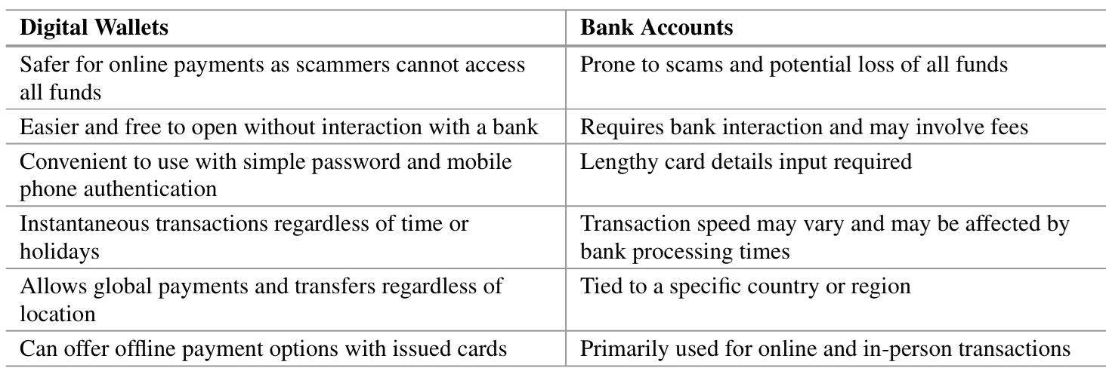
Digital Wallet Vs. Bank Account

Slide 39
Bitcoin Transaction
Bitcoin’s primary function is to facilitate transactions.
Bitcoin’s other features are all built around making it possible to produce, broadcast, validate, and, finally, add transactions to the global database of transactions (the blockchain).
In the Bitcoin network, monetary transfers are encoded in data structures called transactions.
Bitcoin’s blockchain, a decentralized global database that acts as a global double-entry accounting system, records all transactions publicly.

Slide 40
Life Cycle of Transaction
There are multiple steps involved in the creation of, validation of, and addition to the blockchain that constitute the lifespan of a Bitcoin transaction.
Creation and Broadcasting
The process of transferring money begins when an authorized document is created and signed by one or more parties. Once the transaction has been validated, it is broadcast on the Bitcoin network, where each node is responsible for validating and spreading the news of the transaction to other nodes.
Verification and Inclusion
A mining node checks the transaction and verifies its legitimacy. When a transaction has been validated, it is added to the blockchain by being included in a block of previous transactions. To be permanently recorded and recognized as legitimate by all participants, subsequent blocks (confirmations) must be used. A new transaction life cycle can begin when the money are spent by the new owner.

Slide 41
Life Cycle of Transaction
There are multiple steps involved in the creation of, validation of, and addition to the blockchain that constitute the lifespan of a Bitcoin transaction.
Creation and Broadcasting
The process of transferring money begins when an authorized document is created and signed by one or more parties. Once the transaction has been validated, it is broadcast on the Bitcoin network, where each node is responsible for validating and spreading the news of the transaction to other nodes.
Verification and Inclusion
A mining node checks the transaction and verifies its legitimacy. When a transaction has been validated, it is added to the blockchain by being included in a block of previous transactions. To be permanently recorded and recognized as legitimate by all participants, subsequent blocks (confirmations) must be used. A new transaction life cycle can begin when the money are spent by the new owner.

Slide 42
Creation of Transaction
The process of creating a Bitcoin transaction is similar to writing a paper check in several ways. However, there are some fundamental differences due to the decentralized and digital nature of Bitcoin. Let’s break down the key points of the statement with suitable examples:
A Bitcoin Transaction Is Like a Check in Concept
Just like writing a check indicates the intent to transfer money but does not immediately move funds, a Bitcoin transaction is an unsigned document stating the sender’s intention to transfer a certain amount of Bitcoin to a recipient.
  Example: Suppose Alice wants to send 1 Bitcoin (BTC) to Bob. She creates a transaction specifying that 1 BTC should be sent to Bob’s Bitcoin address. However, until it is signed and broadcast to the network, this transaction is just a draft—similar to a written check that hasn't been signed or deposited.

Slide 43
Creation of Transaction
The Creator and Signer Can Be Different
In traditional banking, the person who writes a check may or may not be the one who signs it. Similarly, in Bitcoin, anyone can draft a transaction, but only the owner of the Bitcoin (i.e., the person with the private key) can sign it to make it valid.
  Example: A company's finance team may draft a Bitcoin transaction to pay a supplier. However, the company’s CEO (who holds the private key) must sign the transaction to approve the payment. This is similar to how an accounts payable clerk can prepare a check, but only an authorized person can sign it.

Slide 44
Creation of Transaction
Bitcoin Transactions Do Not Specify a Bank Account
Unlike checks, which clearly state the source account, Bitcoin transactions do not have an explicit “account” from which funds are deducted. Instead, Bitcoin uses UTXOs (Unspent Transaction Outputs)—unspent amounts from previous transactions—to fund new transactions.
  Example: If Alice has received BTC from multiple sources in the past, her wallet will automatically select the necessary UTXOs to cover the amount she wants to send. There is no single "bank account" that holds all her BTC; rather, it is a collection of unspent outputs.

Slide 45
Creation of Transaction
Signing the Transaction Makes It Valid
A Bitcoin transaction must be cryptographically signed using the sender’s private key before it is considered valid. This ensures authenticity and prevents fraud.
  Example: If Alice has created a transaction to send 1 BTC to Bob, she must sign it using her private key. If she does not sign it, the Bitcoin network will reject it as invalid.
Broadcasting to the Network and Adding to the Blockchain
Once a transaction is signed, it is broadcast to the Bitcoin network. Miners then verify and include it in the blockchain, the public ledger of Bitcoin transactions.
  Example: After Alice signs the transaction and broadcasts it, miners validate it and add it to a new block. Once the block is confirmed, Bob officially receives the 1 BTC.

Slide 46
Creation of Transaction
Bitcoin Transaction vs. Check Transaction
Feature | Paper Check | Bitcoin Transaction
Creation | A check is written with details (amount, payee, etc.). | A Bitcoin transaction is drafted with details.
Signing | The account holder signs the check to validate it. | The sender signs the transaction using their private key.
Source of Funds | Clearly mentions a specific bank account. | Uses UTXOs (unspent previous transactions) as inputs.
Verification | Bank processes and verifies before approving. | Bitcoin miners verify and include it in the blockchain.
Execution | The recipient deposits it; the bank transfers funds. | The network confirms the transaction, transferring BTC.

Slide 47
Broadcasting Bitcoin Transaction
Delivering a Bitcoin transaction to the network guarantees that it will be seen by many nodes and added to the blockchain.
Thousands of Bitcoin nodes need to receive a small data structure of about 300–400 bytes, which represents a transaction.
As long as many nodes are employed to guarantee propagation, senders are not required to trust the nodes used for broadcasting.
Since the transaction is signed and does not include any private information, nodes do not need to trust the identity of the sender.
Unlike credit card transactions, which require encrypted networks, Bitcoin transactions can be broadcast publicly via any suitable network transport technology.

Slide 48
Propagating Transactions on the Bitcoin Network
When a Bitcoin transaction is delivered to a node on the Bitcoin network, that node is responsible for verifying the legitimacy of the transaction.
If the transaction is genuine, the node will forward it to other nodes in the network and signal back to the sender that the transaction was successful.
In the event of an invalid transaction, the node will send a rejection message back to the sender.
Through a technique known as flooding, transactions are broadcast from a central node to all of the peer nodes with which it communicates. Once a transaction is processed and accepted by the network, it spreads out to every node in an exponential fashion. The Bitcoin network is made to spread transactions and blocks quickly and reliably, protecting against spam, denial-of-service attacks, and other possible problems. Each node checks transactions on its own, which stops bad transactions from growing past a single node.

